Slide 1
Python String

Slide 2
Agenda

Slide 3
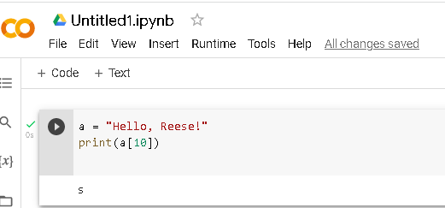

Slide 4
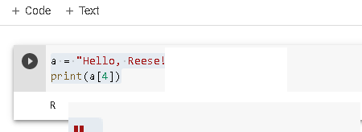

Slide 5

Looping String

Slide 6

String Length

Slide 7
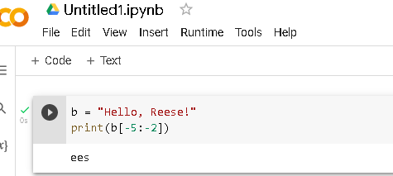

Slide 8


Slide 9
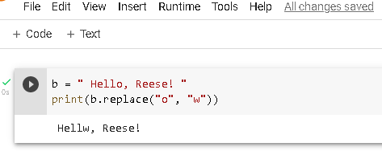

Slide 10
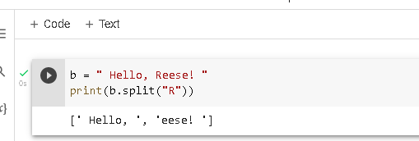

Slide 11
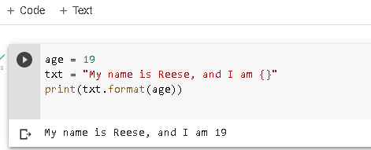

Slide 12
